Slide 1
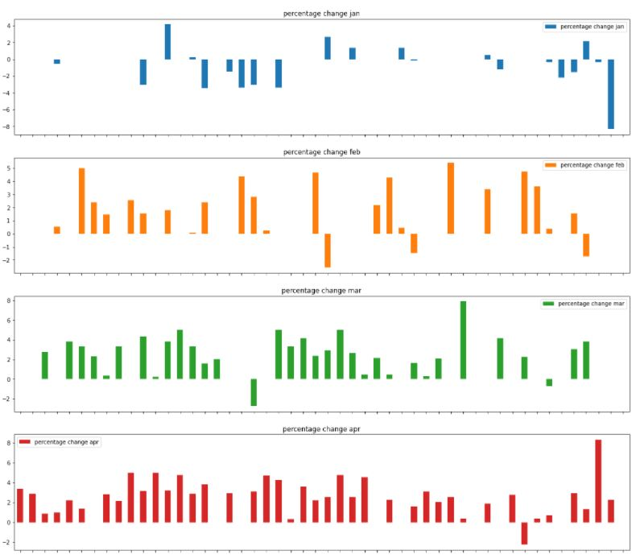
Growth % for rentals and purchases

Slide 2
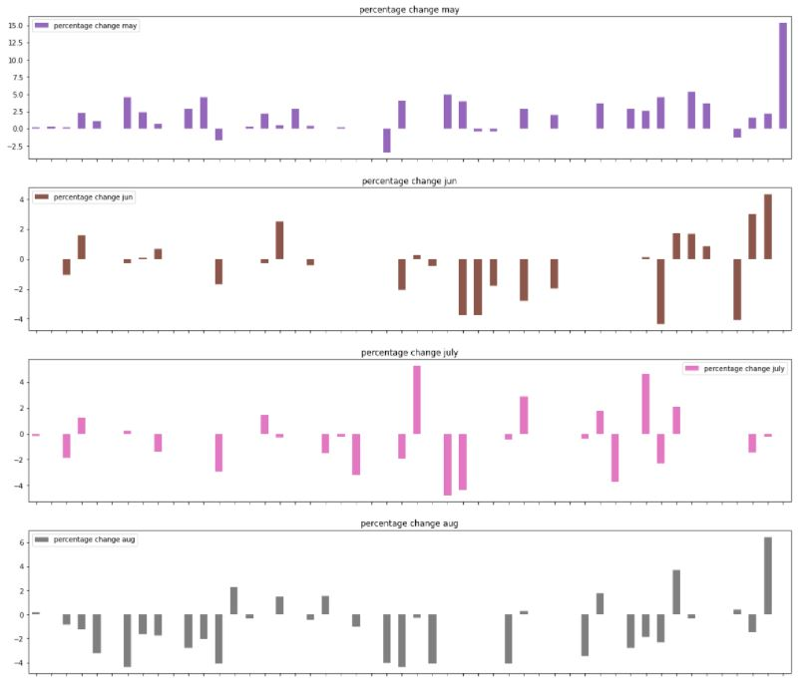

Slide 3
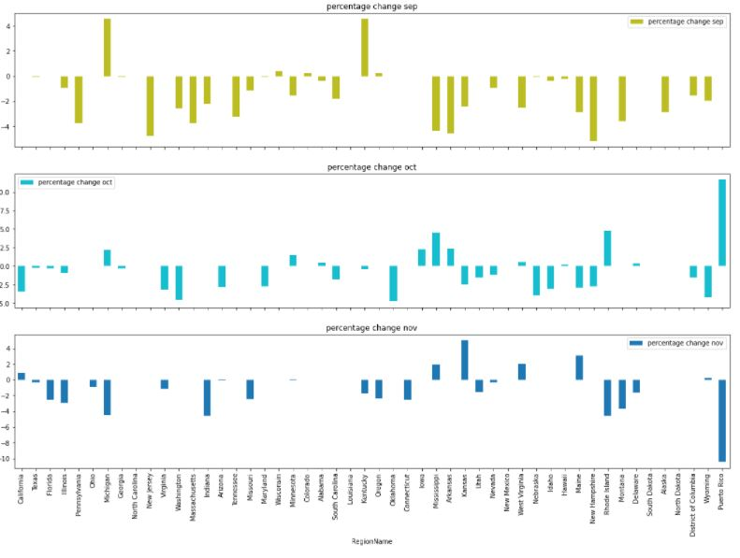

Slide 4
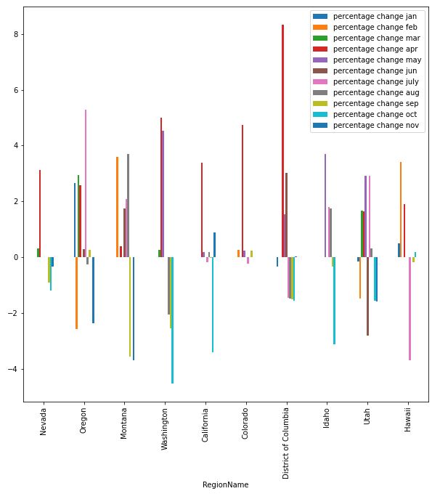
Growth trend for top 10 states that are prefered renting

Slide 5
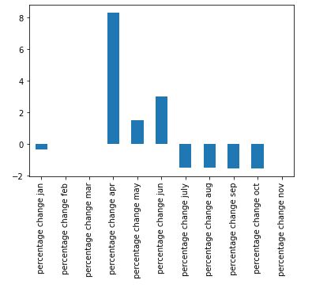
Calculating rent growth for 1 state
District of Columbia

Slide 6
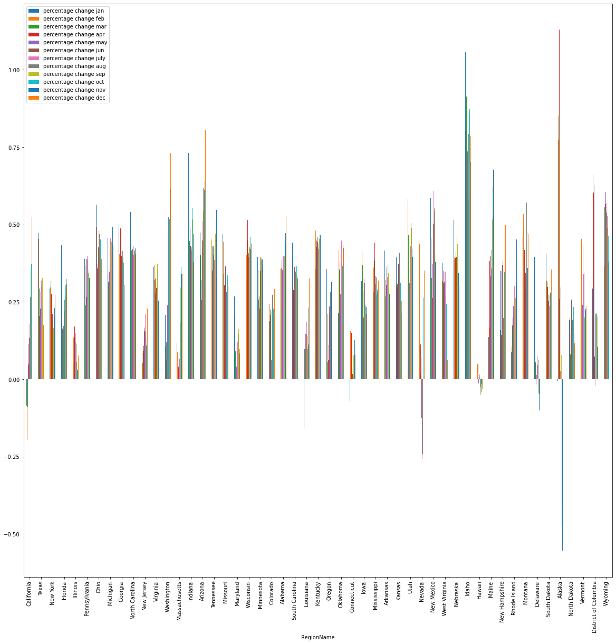
Growth % calculation for purchases

Slide 7
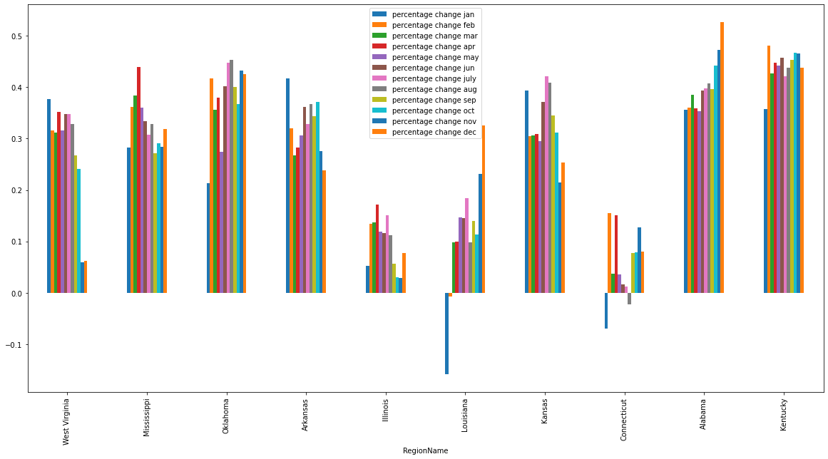
Growth trend for top 10 states that are prefered buying

Slide 8
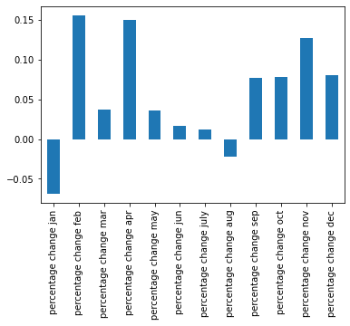
Growth for 1 state preferred to buy
Connecticut

